Slide 1
CS162 Operating Systems and Systems Programming Lecture 4 Introduction to I/O, Sockets, Networking
January 29th, 2018
Profs. Anthony D. Joseph and Jonathan Ragan-Kelley
http://cs162.eecs.Berkeley.edu

Slide 2
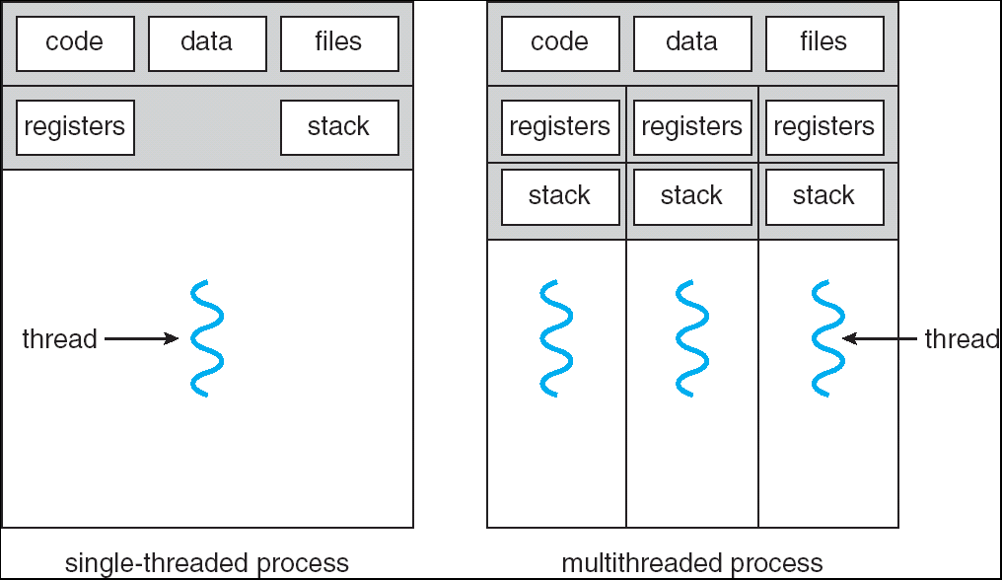
Recall: Single and Multithreaded Processes
Threads encapsulate concurrency: “Active” component
Address spaces encapsulate protection: “Passive” part
Keeps buggy program from trashing the system
Why have multiple threads per address space?
Notes:
Sometimes need parallelism for a single job, and processes are very expensive – to start, switch between, and to communicate between

Slide 3
Can a process create a process ?
Yes! Unique identity of process is the “process ID” (or PID)
fork() system call creates a copy of current process with a new PID
Return value from fork(): integer
When > 0:
Running in (original) Parent process
return value is pid of new child
When = 0:
Running in new Child process
When < 0:
Error! Must handle somehow
Running in original process
All state of original process duplicated in both Parent and Child!
Memory, File Descriptors (later today), etc…
Notes:
Think of fork as creating a clone—a perfect, bit-for-bit copy of the process at the moment we call fork.
The only difference is the PID.

Slide 4
fork1.c
#include <stdlib.h>
#include <stdio.h>
#include <string.h>
#include <unistd.h>
#include <sys/types.h>
#define BUFSIZE 1024
int main(int argc, char *argv[])
{
char buf[BUFSIZE];
size_t readlen, writelen, slen;
pid_t cpid, mypid;
pid_t pid = getpid(); /* get current processes PID */
printf("Parent pid: %d\n", pid);
cpid = fork();
if (cpid > 0) { /* Parent Process */
mypid = getpid();
printf("[%d] parent of [%d]\n", mypid, cpid);
} else if (cpid == 0) { /* Child Process */
mypid = getpid();
printf("[%d] child of [%d]\n", mypid, pid);
} else {
perror("Fork failed");
exit(1);
}
exit(0);
}

Slide 5
UNIX Process Management
UNIX fork – system call to create a copy of the current process, and start it running
No arguments!
UNIX exec – system call to change the program being run by the current process
UNIX wait – system call to wait for a process to finish
UNIX signal – system call to send a notification to another process
UNIX man pages: fork(2), exec(3), wait(2), signal(3)
Notes:
UNIX splits creating a process into two steps, each of them a lot simpler.
…now let’s look at an example of using `wait`…

Slide 6
fork2.c
int status;
pid_t pid = getpid(); /* get current processes PID */
…
cpid = fork();
if (cpid > 0) { /* Parent Process */
mypid = getpid();
printf("[%d] parent of [%d]\n", mypid, cpid);
tcpid = wait(&status);
printf("[%d] bye %d(%d)\n", mypid, tcpid, status);
} else if (cpid == 0) { /* Child Process */
mypid = getpid();
printf("[%d] child of [%d]\n", mypid, pid);
}
…

Slide 7
UNIX Process Management
Notes:
So what we’ve seen is some basic UNIX process management.
How is this used – typically, fork a process, child and parent are now both running the same program. One sets up the child program, and runs exec – becoming the new program
The parent, usually, waits for the child to finish
This is the basic template for what a SHELL does…

Slide 8
Shell
A shell is a job control system
Allows user to create and manage a set of programs to do some task
Windows, MacOS, Linux all have shells
Example: to compile a C program
cc –c sourcefile1.c
cc –c sourcefile2.c
ln –o program sourcefile1.o sourcefile2.o
./program
HW1
Notes:
And this is the basis for how a shell works.
…and you’re not just going to be using the shell, you’re going to create one—that’s homework 1!

Slide 9
Signals – infloop.c
#include <stdlib.h>
#include <stdio.h>
#include <sys/types.h>
#include <unistd.h>
#include <signal.h>
void signal_callback_handler(int signum)
{
printf("Caught signal %d - phew!\n",signum);
exit(1);
}
int main() {
signal(SIGINT, signal_callback_handler);
while (1) {}
}
Got top?
Notes:
The next
…what’s going to happen?
(Nothing? Top: 100% CPU)
(ctrl-C – sends interrupt signal!)

Slide 10
Process Races: fork3.c
int i;
cpid = fork();
if (cpid > 0) {
mypid = getpid();
printf("[%d] parent of [%d]\n", mypid, cpid);
for (i=0; i<100; i++) {
printf("[%d] parent: %d\n", mypid, i);
// sleep(1);
}
} else if (cpid == 0) {
mypid = getpid();
printf("[%d] child\n", mypid);
for (i=0; i>-100; i--) {
printf("[%d] child: %d\n", mypid, i);
// sleep(1);
}
}
Question: What does this program print?
Does it change if you add in one of the sleep() statements?
Notes:
In the parent we have a loop…
In the child we have…
What will happen—what will we see when we execute this program?
This one example sums up almost everything we’ve seen today!

Slide 11
Summary
Process: execution environment with Restricted Rights
Address Space with One or More Threads
Owns memory (address space)
Owns file descriptors, file system context, …
Encapsulate one or more threads sharing process resources
Interrupts
Hardware mechanism for regaining control from user
Notification that events have occurred
User-level equivalent: Signals
Processes controlling processes
Fork, Exec, Wait, Signal

Slide 12
How Does the Kernel Provide Services?
You said that applications request services from the operating system via syscall, but …
I’ve been writing all sort of useful applications and I never ever saw a “syscall” !!!
That’s right.
It was buried in the programming language runtime library (e.g., libc.a)
… Layering

Slide 13
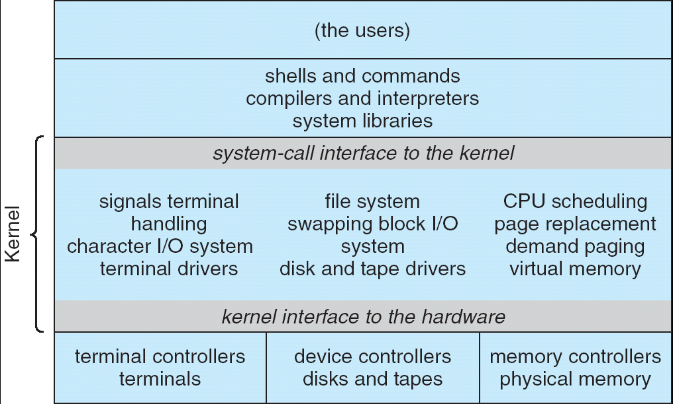
Recall: UNIX System Structure
Applications
User Mode
Standard Libs
Kernel Mode
Hardware

Slide 14
OS Run-Time Library
Proc 1
Proc 2
Proc n
…
OS
Appln
login
Window Manager
…
OS library
OS library
OS library
OS

Slide 15
A Kind of Narrow Waist
Word Processing
Compilers
Web Browsers
Email
Databases
Web Servers
Application / Service
Portable OS Library
OS
User
System Call
Interface
System
Portable OS Kernel
Software
Platform support, Device Drivers
Hardware
x86
PowerPC
ARM
PCI
Ethernet (1Gbs/10Gbs)
802.11 a/g/n/ac
SCSI
Graphics
Thunderbolt

Slide 16
Key Unix I/O Design Concepts
Uniformity
file operations, device I/O, and interprocess communication through open, read/write, close
Allows simple composition of programs
find | grep | wc …
Open before use
Provides opportunity for access control and arbitration
Sets up the underlying machinery, i.e., data structures
Byte-oriented
Even if blocks are transferred, addressing is in bytes
Kernel buffered reads
Streaming and block devices looks the same
read blocks process, yielding processor to other task

Slide 17
Putting it together: web server
Kernel buffer reads
Server
4. parse request
9. format reply
request
buffer
reply
buffer
network
socket
read
3. kernel
copy
10. network
socket
write
5. file
read
8. kernel
copy
syscall
syscall
Kernel
wait
RTU
11. kernel copy
from user buffer
to network buffer
RTU
interrupt
interrupt
2. copy arriving
packet (DMA)
12. format outgoing
packet and DMA
6. disk
request
7. disk data
(DMA)
Hardware
Network
interface
Disk interface
Request
Reply

Slide 18
Key Unix I/O Design Concepts
Uniformity
file operations, device I/O, and interprocess communication through open, read/write, close
Allows simple composition of programs
find | grep | wc …
Open before use
Provides opportunity for access control and arbitration
Sets up the underlying machinery, i.e., data structures
Byte-oriented
Even if blocks are transferred, addressing is in bytes
Kernel buffered reads
Streaming and block devices looks the same
read blocks process, yielding processor to other task
Kernel buffered writes
Completion of out-going transfer decoupled from the application, allowing it to continue

Slide 19
Putting it together: web server
Kernel buffer writes
Server
4. parse request
9. format reply
request
buffer
reply
buffer
network
socket
read
3. kernel
copy
10. network
socket
write
5. file
read
8. kernel
copy
syscall
syscall
Kernel
wait
RTU
11. kernel copy
from user buffer
to network buffer
RTU
interrupt
interrupt
2. copy arriving
packet (DMA)
12. format outgoing
packet and DMA
6. disk
request
7. disk data
(DMA)
Hardware
Network
interface
Disk interface
Request
Reply

Slide 20
Key Unix I/O Design Concepts
Uniformity
file operations, device I/O, and interprocess communication through open, read/write, close
Allows simple composition of programs
find | grep | wc …
Open before use
Provides opportunity for access control and arbitration
Sets up the underlying machinery, i.e., data structures
Byte-oriented
Even if blocks are transferred, addressing is in bytes
Kernel buffered reads
Streaming and block devices looks the same
read blocks process, yielding processor to other task
Kernel buffered writes
Completion of out-going transfer decoupled from the application, allowing it to continue
Explicit close

Slide 21
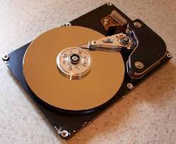
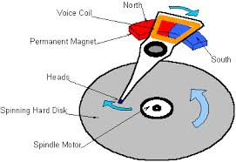
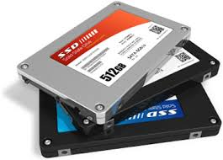

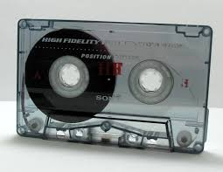
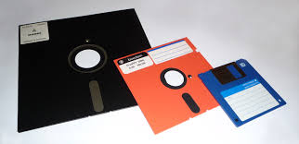
I/O & Storage Layers
Application / Service
streams
High Level I/O
Low Level I/O
handles
Syscall
registers
File System
descriptors
I/O Driver
Commands and Data Transfers
Disks, Flash, Controllers, DMA

Slide 22
Administrivia
Waitlist was closed Friday
Concurrent enrollments forwarded to dept and Dean
Recommendation: Read assigned readings before lecture
Group sign up with the autograder this week
Get finding groups ASAP – deadline Friday 2/2 at 11:59PM
4 people in a group!
TA preference signup form due Monday 2/5 at 11:59PM
Everyone in a group must have the same TA!
Preference given to same section
Participation: Get to know your TA!

Slide 23
Break

Slide 24
The File System Abstraction
High-level idea
Files live in hierarchical namespace of filenames
File
Named collection of data in a file system
File data
Text, binary, linearized objects
File Metadata: information about the file
Size, Modification Time, Owner, Security info
Basis for access control
Directory
“Folder” containing files & Directories
Hierachical (graphical) naming
Path through the directory graph
Uniquely identifies a file or directory
/home/ff/cs162/public_html/sp18/index.html
Links and Volumes (later)

Slide 25
C High-Level File API – Streams (review)
Operate on “streams” - sequence of bytes, whether text or data, with a position
#include <stdio.h>
FILE *fopen( const char *filename, const char *mode );
int fclose( FILE *fp );
Mode Text | Binary | Descriptions
r | rb | Open existing file for reading
w | wb | Open for writing; created if does not exist
a | ab | Open for appending; created if does not exist
r+ | rb+ | Open existing file for reading & writing.
w+ | wb+ | Open for reading & writing; truncated to zero if exists, create otherwise
a+ | ab+ | Open for reading & writing. Created if does not exist. Read from beginning, write as append
Don’t forget to flush

Slide 26
Connecting Processes, Filesystem, and Users
Process has a ‘current working directory’
Absolute Paths
/home/ff/cs162
Relative paths
index.html, ./index.html - current WD
../index.html - parent of current WD
~, ~cs162 - home directory

Slide 27
C API Standard Streams
Three predefined streams are opened implicitly when a program is executed
FILE *stdin – normal source of input, can be redirected
FILE *stdout – normal source of output, can be redirected
FILE *stderr – diagnostics and errors, can be redirected
STDIN / STDOUT enable composition in Unix
Recall: Use of pipe symbols connects STDOUT and STDIN
find | grep | wc …

Slide 28

C high level File API – Stream Ops
#include <stdio.h>
// character oriented
int fputc( int c, FILE *fp ); // rtn c or EOF on err
int fputs( const char *s, FILE *fp ); // rtn >0 or EOF
int fgetc( FILE * fp );
char *fgets( char *buf, int n, FILE *fp );

Slide 29
C high level File API – Stream Ops
#include <stdio.h>
// character oriented
int fputc( int c, FILE *fp ); // rtn c or EOF on err
int fputs( const char *s, FILE *fp ); // rtn >0 or EOF
int fgetc( FILE * fp );
char *fgets( char *buf, int n, FILE *fp );
// block oriented
size_t fread(void *ptr, size_t size_of_elements,
size_t number_of_elements, FILE *a_file);
size_t fwrite(const void *ptr, size_t size_of_elements,
size_t number_of_elements, FILE *a_file);

Slide 30
C high level File API – Stream Ops
#include <stdio.h>
// character oriented
int fputc( int c, FILE *fp ); // rtn c or EOF on err
int fputs( const char *s, FILE *fp ); // rtn >0 or EOF
int fgetc( FILE * fp );
char *fgets( char *buf, int n, FILE *fp );
// block oriented
size_t fread(void *ptr, size_t size_of_elements,
size_t number_of_elements, FILE *a_file);
size_t fwrite(const void *ptr, size_t size_of_elements,
size_t number_of_elements, FILE *a_file);
// formatted
int fprintf(FILE *restrict stream, const char *restrict format, ...);
int fscanf(FILE *restrict stream, const char *restrict format, ...);

Slide 31
Example Code
#include <stdio.h>
#define BUFLEN 256
FILE *outfile;
char mybuf[BUFLEN];
int storetofile() {
char *instring;
outfile = fopen("/usr/homes/testing/tokens", "w+");
if (!outfile)
return (-1); // Error!
while (1) {
instring = fgets(mybuf, BUFLEN, stdin); // catches overrun!
// Check for error or end of file (^D)
if (!instring || strlen(instring)==0) break;
// Write string to output file, exit on error
if (fputs(instring, outfile)< 0) break;
}
fclose(outfile); // Flushes from userspace
}

Slide 32
C Stream API positioning
int fseek(FILE *stream, long int offset, int whence); long int ftell (FILE *stream)
void rewind (FILE *stream)
offset (SEEK_SET)
offset (SEEK_END)
offset (SEEK_CUR)
Preserves high level abstraction of uniform stream of objects
Adds buffering for performance

Slide 33
What’s below the surface ??
Application / Service
High Level I/O
streams
Low Level I/O
handles
registers
Syscall
File System
descriptors
I/O Driver
Commands and Data Transfers
Disks, Flash, Controllers, DMA

Slide 34
C Low level I/O
Operations on File Descriptors – as OS object representing the state of a file
User has a “handle” on the descriptor
#include <fcntl.h>
#include <unistd.h>
#include <sys/types.h>
int open (const char *filename, int flags [, mode_t mode])
int creat (const char *filename, mode_t mode)
int close (int filedes)
Bit vector of:
Access modes (Rd, Wr, …)
Open Flags (Create, …)
Operating modes (Appends, …)
Bit vector of Permission Bits:
User|Group|Other X R|W|X
http://www.gnu.org/software/libc/manual/html_node/Opening-and-Closing-Files.html

Slide 35
C Low Level: standard descriptors
#include <unistd.h>
STDIN_FILENO - macro has value 0
STDOUT_FILENO - macro has value 1
STDERR_FILENO - macro has value 2
int fileno (FILE *stream)
FILE * fdopen (int filedes, const char *opentype)
Crossing levels: File descriptors vs. streams
Don’t mix them!

Slide 36
C Low Level Operations
ssize_t read (int filedes, void *buffer, size_t maxsize)
- returns bytes read, 0 => EOF, -1 => error
ssize_t write (int filedes, const void *buffer, size_t size)
- returns bytes written
off_t lseek (int filedes, off_t offset, int whence)
int fsync (int fildes) – wait for i/o to finish
void sync (void) – wait for ALL to finish
When write returns, data is on its way to disk and can be read, but it may not actually be permanent!

Slide 37
And lots more !
TTYs versus files
Memory mapped files
File Locking
Asynchronous I/O
Generic I/O Control Operations
Duplicating descriptors
int dup2 (int old, int new)
int dup (int old)

Slide 38
Another example: lowio-std.c
#include <stdlib.h>
#include <stdio.h>
#include <string.h>
#include <unistd.h>
#include <sys/types.h>
#define BUFSIZE 1024
int main(int argc, char *argv[])
{
char buf[BUFSIZE];
ssize_t writelen = write(STDOUT_FILENO, "I am a process.\n", 16);
ssize_t readlen = read(STDIN_FILENO, buf, BUFSIZE);
ssize_t strlen = snprintf(buf, BUFSIZE,"Got %zd chars\n", readlen);
writelen = strlen < BUFSIZE ? strlen : BUFSIZE;
write(STDOUT_FILENO, buf, writelen);
exit(0);
}

Slide 39
What’s below the surface ??
Application / Service
High Level I/O
streams
Low Level I/O
handles
registers
Syscall
File System
descriptors
I/O Driver
Commands and Data Transfers
Disks, Flash, Controllers, DMA

Slide 40
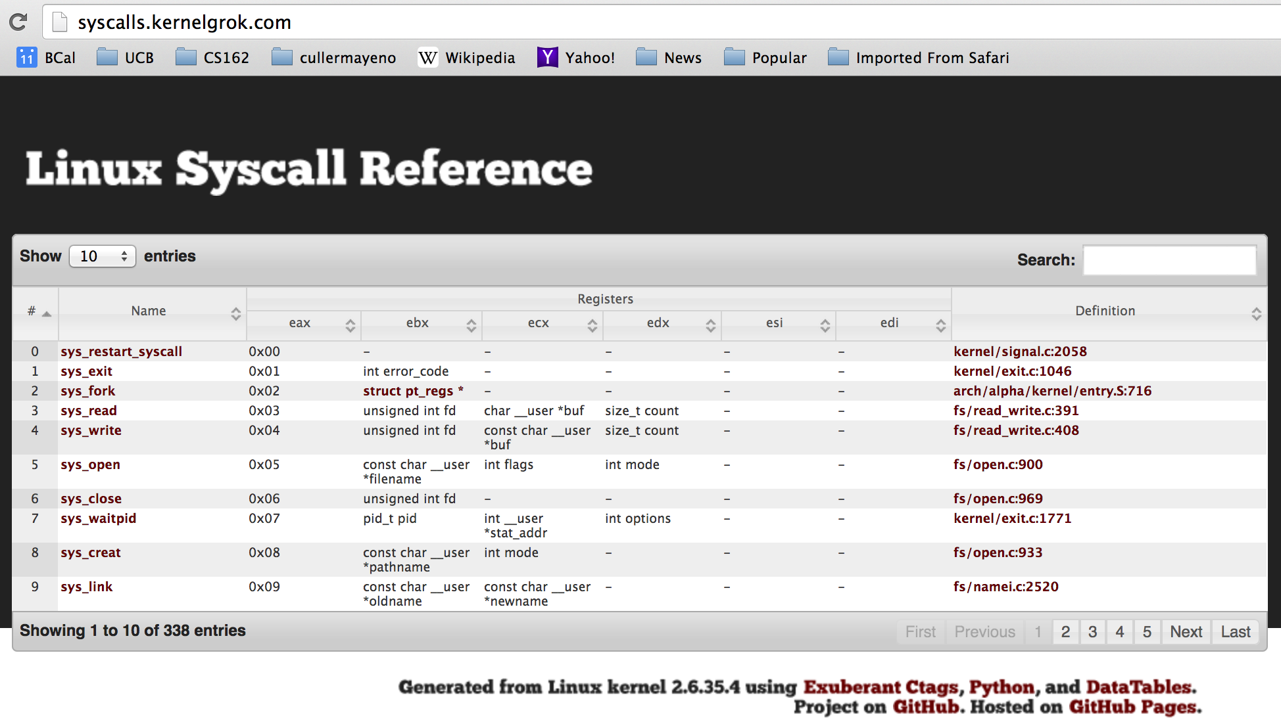
Recall: SYSCALL
Low level lib parameters are set up in registers and syscall instruction is issued
A type of synchronous exception that enters well-defined entry points into kernel

Slide 41
What’s below the surface ??
File descriptor number
- an int
Application / Service
streams
High Level I/O
handles
Low Level I/O
Syscall
registers
File System
descriptors
File Descriptors
- a struct with all the info about the files
I/O Driver
Commands and Data Transfers
Disks, Flash, Controllers, DMA

Slide 42
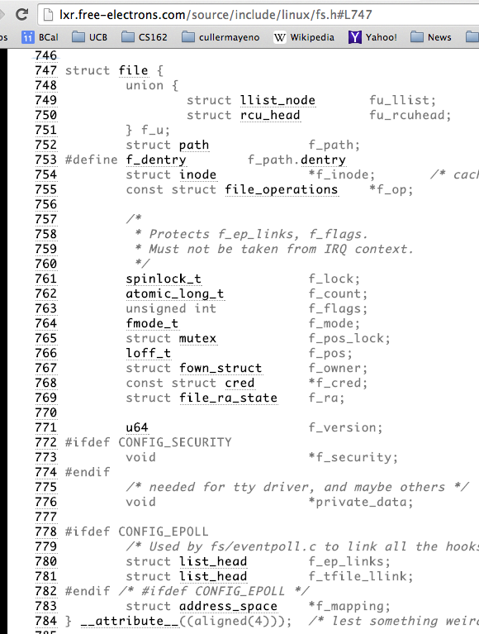
Internal OS File Descriptor
Internal Data Structure describing everything about the file
Where it resides
Its status
How to access it
Pointer: struct file *file

Slide 43
File System: from syscall to driver
In fs/read_write.c
ssize_t vfs_read(struct file *file, char __user *buf, size_t count, loff_t *pos)
{
ssize_t ret;
if (!(file->f_mode & FMODE_READ)) return -EBADF;
if (!file->f_op || (!file->f_op->read && !file->f_op->aio_read))
return -EINVAL;
if (unlikely(!access_ok(VERIFY_WRITE, buf, count))) return -EFAULT;
ret = rw_verify_area(READ, file, pos, count);
if (ret >= 0) {
count = ret;
if (file->f_op->read)
ret = file->f_op->read(file, buf, count, pos);
else
ret = do_sync_read(file, buf, count, pos);
if (ret > 0) {
fsnotify_access(file->f_path.dentry);
add_rchar(current, ret);
}
inc_syscr(current);
}
return ret;
}

Slide 44
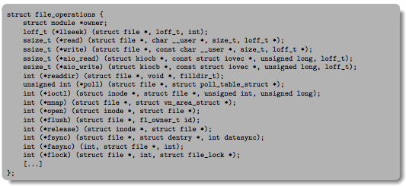
Lower Level Driver
Associated with particular hardware device
Registers / Unregisters itself with the kernel
Handler functions for each of the file operations

Slide 45
Recall: Device Drivers
Device Driver: Device-specific code in the kernel that interacts directly with the device hardware
Supports a standard, internal interface
Same kernel I/O system can interact easily with different device drivers
Special device-specific configuration supported with the ioctl() system call
Device Drivers typically divided into two pieces:
Top half: accessed in call path from system calls
implements a set of standard, cross-device calls like open(), close(), read(), write(), ioctl(), strategy()
This is the kernel’s interface to the device driver
Top half will start I/O to device, may put thread to sleep until finished
Bottom half: run as interrupt routine
Gets input or transfers next block of output
May wake sleeping threads if I/O now complete

Slide 46
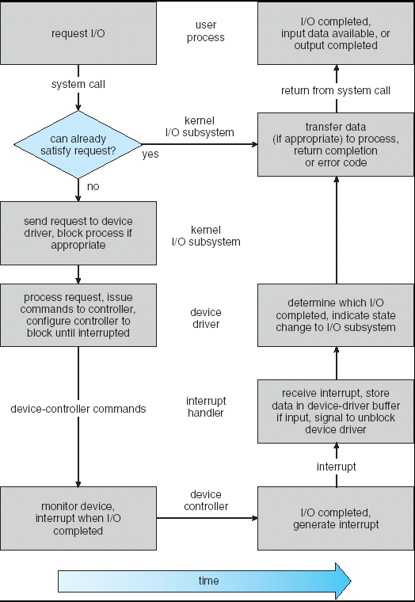
Life Cycle of An I/O Request
User
Program
Kernel I/O
Subsystem
Device Driver
Top Half
Device Driver
Bottom Half
Device
Hardware

Slide 47
So what happens when you fgetc?
Application / Service
High Level I/O
streams
Low Level I/O
handles
registers
Syscall
descriptors
File System
I/O Driver
Commands and Data Transfers
Disks, Flash, Controllers, DMA

Slide 48
Communication between processes
Can we view files as communication channels?
Producer and Consumer of a file may be distinct processes
May be separated in time (or not)
However, what if data written once and consumed once?
Don’t we want something more like a queue?
Can still look like File I/O!
write(wfd, wbuf, wlen);
n = read(rfd,rbuf,rmax);

Slide 49
Communication Across the world looks like file IO
write(wfd, wbuf, wlen);
n = read(rfd,rbuf,rmax);
Connected queues over the Internet
But what’s the analog of open?
What is the namespace?
How are they connected in time?

Slide 50
Request Response Protocol
Client (issues requests)
Server (performs operations)
write(rqfd, rqbuf, buflen);
requests
n = read(rfd,rbuf,rmax);
wait
service request
write(wfd, respbuf, len);
responses
n = read(resfd,resbuf,resmax);

Slide 51
Request Response Protocol
Client (issues requests)
Server (performs operations)
write(rqfd, rqbuf, buflen);
requests
n = read(rfd,rbuf,rmax);
wait
service request
write(wfd, respbuf, len);
responses
n = read(resfd,resbuf,resmax);

Slide 52
Client-Server Models
Client 1
Client 2
Server
***
Client n
File servers, web, FTP, Databases, …
Many clients accessing a common server

Slide 53
Conclusion (I)
System Call Interface is “narrow waist” between user programs and kernel
Streaming IO: modeled as a stream of bytes
Most streaming I/O functions start with “f” (like “fread”)
Data buffered automatically by C-library functions
Low-level I/O:
File descriptors are integers
Low-level I/O supported directly at system call level
STDIN / STDOUT enable composition in Unix
Use of pipe symbols connects STDOUT and STDIN
find | grep | wc …

Slide 54
Conclusion (II)
Device Driver: Device-specific code in the kernel that interacts directly with the device hardware
Supports a standard, internal interface
Same kernel I/O system can interact easily with different device drivers
File abstraction works for inter-processes communication (local or Internet)

